Slide 1
PCF Methods
16 September 2013
Notes:
Guidewire training materials contain Guidewire proprietary information that is subject to confidentiality and non-disclosure agreements. You agree to use the information in this manual solely for the purpose of training to implement Guidewire software solutions. You also agree not to disclose the information in this manual to third parties or copy this manual without prior written consent from Guidewire. Guidewire training may be given only by Guidewire employees or certified Guidewire partners under the appropriate agreement with Guidewire.

Slide 2
Lesson objectives
By the end of this lesson, you should be able to:
Describe the different ways methods can be written
Create PCF methods
Implement common use cases for PCF methods
This lesson uses the notes section for additional explanation and information. To view the notes in PowerPoint, choose View→Normal or View→Notes Page. If you choose to print the notes for the lesson, be sure to select “Print hidden slides.”

Slide 3
Lesson outline
Overview of Gosu methods
Creating PCF methods
Common use cases for PCF methods

Slide 4
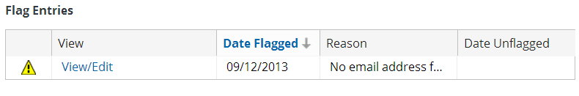
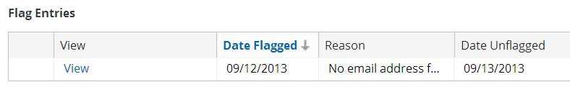
Methods
A method is a set of statements that executes a logical unit of work
function popupButtonText If flag entry's IsEditable boolean is true return "View/Edit" Otherwise, return "View"
Notes:
The example above shows the impact of the FlagEntriesLV PCF file's popupButtonText method. For a given flag entry, the method returns "View/Edit" (if the flag entry is editable) or "View" (if the flag entry is not editable). A flag entry's IsEditable field is true if the flag entry is open and the user has sufficient permissions to resolve the flag entry.

Slide 5
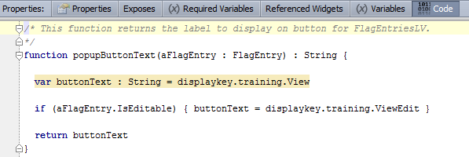
Method syntax
Can take input parameters, return a result, or both
Syntax: function functionName (inputvar : datatype) : returnType { // code to execute method return returnValue }
input parameter
return value
Notes:
The recommended capitalization convention for methods is to use camelcase with an initial lower-case letter (such as popupButtonText, calculateAvailability, or assignToNextAvailableUser).
A method can return any type of value found in Gosu, including:
Boolean
String
Integer
Object from the data model
Arrays
Void (no value returned)
You can precede the function keyword with one or more modifier keywords. Guidewire modifiers include public and private, which are access modifiers. A method is public by default, meaning that it can be referenced from anywhere in a Guidewire application that uses Gosu. In contrast, a private method can be referenced only within the library in which it is defined.

Slide 6
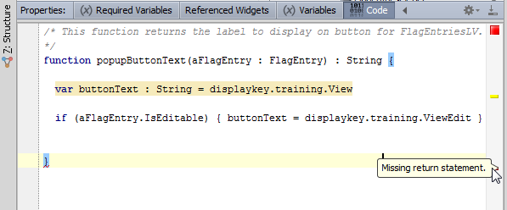
Methods with return values
All code paths must contain a return statement, or Gosu gives error
Return value must be of the declared return type
What is return value if condition is false?
Notes:
If a method's return type is not void, all code paths must return a value. Gosu requires a return statement for all possible paths through the method including all choices for conditional execution, such as if and switch statements. Gosu also mandates that a value specified in a return statement match the return type declared in the method. A missing return type or a mismatched return value generates a compiler error.
In the example on the slide, the compiler gives an error because the code does not provide a path and return statement for a flag entry whose IsEditable property is false.

Slide 7
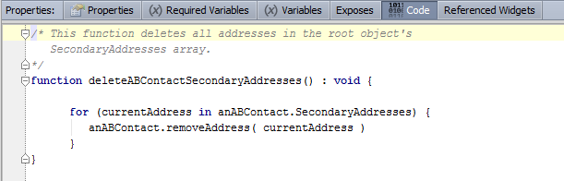
Methods with no return value
If method does not need to return a value:
Set return value to void
Return statements are not required
Notes:
Return statements are not required in a PCF method, but they are allowed. This can be useful if there are situations in which you want execution of the method to stop before the end of the method has been reached.
You can see this example in ABContactAddressesLDV in Studio.

Slide 8



Where can you declare Gosu methods?
PCFs
Method can be used only within that PCF
Discussed in this lesson
Enhancements
Method associated to given type (such as an entity)
Can only be used by instances of that type
Discussed in "Enhancements" lesson
Classes
Method associated with given class
If declared as static methods, can be used anywhere
Discussed in "Gosu Classes" lesson
Notes:
Class methods can also be non-static. In this case, the method can only be called from an instance of the class. Typically, configuration developers do not write an extensive amount of non-static class methods. Integration developers, however, typically do write both static and non-static class methods.

Slide 9
Lesson outline
Overview of Gosu methods
Creating PCF methods
Common use cases for PCF methods

Slide 10
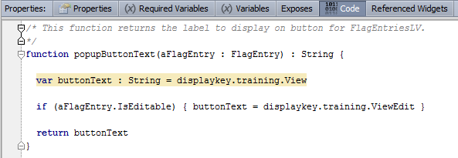
PCF methods
A PCF method is a method declared on a given PCF file's Code tab
Method can be called by properties of PCF file or its widgets
Notes:
Any required variable (declared on the Required Variables tab) or non-required variable (declared on the Variables tab) is inherently known to all PCF methods. You do not need to pass a variable declared on either of these tabs to the PCF method. For example, if the method above required data from the root anABContact object, the method could simply reference anABContact. The object would not need to be included in the method declaration.
PCF methods are available only within the scope of the PCF in which they are declared. They behave as if they have the private access modifier. You can explicitly add an access modifier, but this does not change the inherent scope of the PCF method.
You can see this example in FlagEntriesLV in Studio.

Slide 11
Lesson outline
Gosu methods
Creating PCF methods
Common use cases for PCF methods

Slide 12
Calling PCF methods
Methods can be referenced from location and widget properties
Syntax: functionName (inputParameters)
Although any method can be referenced, the remainder of this lesson focuses on PCF methods
Common use cases include method to execute when:
Given widget is clicked
Given widget is rendered
Given widget's value changes
Event occurs for a given location, such as:
User navigates to that location
Data modifications in that location are committed

Slide 13
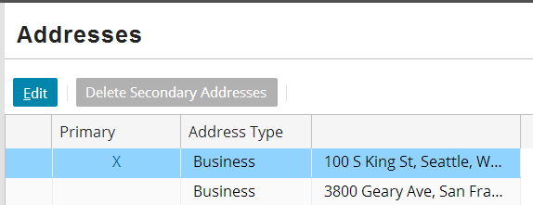
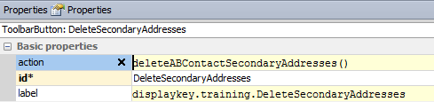
Use case 1: When widget is clicked
Action attribute specifies code to execute when widget is clicked
Notes:
In the example shown above, the "Code" tab belongs to the ABContactAddressesLV PCF file.

Slide 14
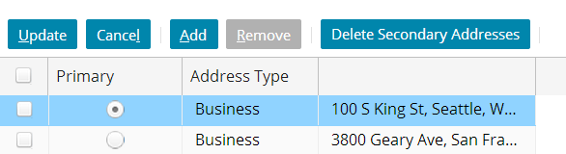
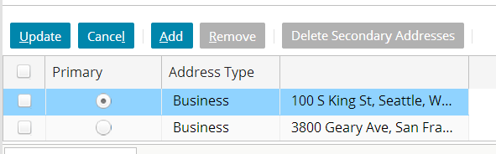
Widget availability
An atomic widget's available property determines when the widget can be clicked
available = true
available = false
Notes:
Relevant to widgets that can be clicked
When true or a condition specified, widget is clickable
When false, widget is unclickable
In the example above, the Delete Secondary Addresses button is available only when in edit mode and only if there are secondary addresses to delete.

Slide 15
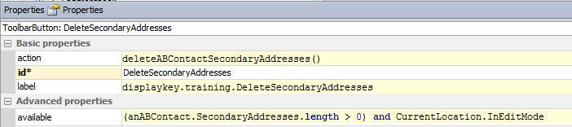
Configuring widget availability
Widget is clickable only if available returns true
Default value is true
Checked only when action property is not null
CurrentLocation.InEditMode can be used to control availability based on edit mode of location
Returns true if current location is in edit mode
Returns false if current location is in read-only mode
Notes:
You can also use a combination of widgets and Gosu to affect whether or not a page is editable. Do the following to create a custom button that puts the current location into edit mode:
In Studio, add a Toolbar Button widget to the desired toolbar.
Click the Properties tab.
Specify CurrentLocation.startEditing() for the action property.
Configure other properties of the widget as desired.
Save the resource.
Reload the metadata.

Slide 16
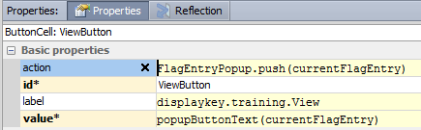
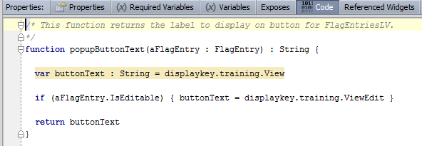
Use case 2: Input or cell button label
Notes:
For input buttons and cell buttons, the value attribute specifies the text to display on the button. This attribute is not available for toolbar buttons.
Note that the label field for cells contains the label for the column, not for the individual cells.

Slide 17
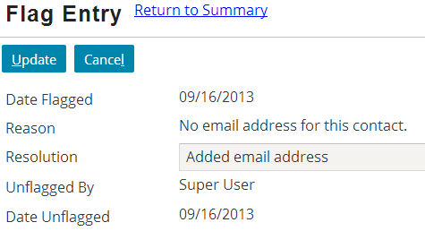
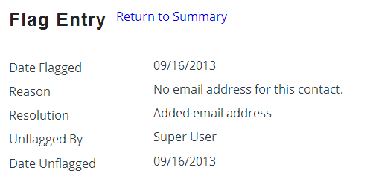
Use case 3: When widget's value changes
Widgets can execute code when their value changes in the application (prior to the value being saved)
This is discussed in detail in the "Server-Side Widget Behavior" lesson
onChange: set UnflagUser to current user set UnflagDate to current date
Notes:
Server-Side Widget Behavior - 17

Slide 18
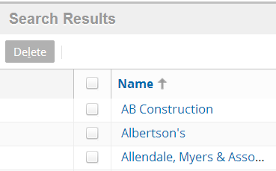
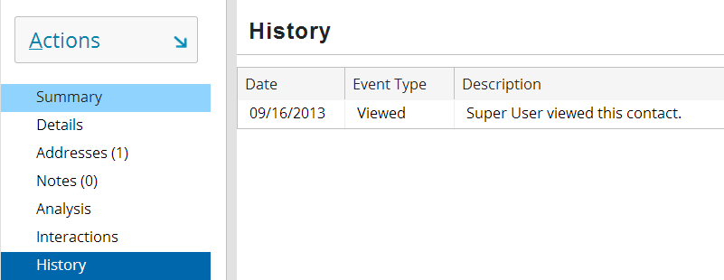
Use case 4 : Navigating to locations
PCF methods can be called in reaction to location events, such as navigating to location
After entering location, create "viewed this contact" history entry
Notes:
The location properties that can call PCF methods include:
afterEnter
Executed immediately after application enters location
beforeCancel or afterCancel
Executed before or after application cancels out of edit mode
beforeCommit or afterCommit
Executed before or after application commits out of edit mode
afterReturnFromPopup
Executed after application returns to location from popup
Locations (such as pages and popups) and atomic widgets (such as inputs, cells, and buttons) have properties that can execute methods. Container widgets (such as detail views, list views, card views, and listdetail views) do not have any properties that can execute methods, however.

Slide 19
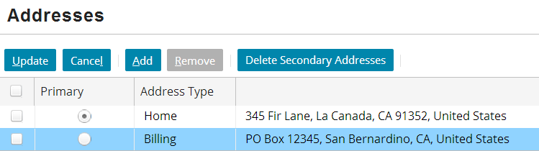
Changing data in PCF methods
When PCF method changes data, those changes are not automatically written to database
If method is called while location is in edit mode, changes are committed when user clicks "Update"
If method must change data while location is in read-only mode, code must commit data manually
deletion of addresses committed when user clicks Update
Notes:
A bundle is a collection of Gosu objects that corresponds to a database transaction. Changes to data in the bundle's objects either succeed as a unit or fail as a unit. In order to manually commit data, the code must manipulate the current bundle. This is an advanced topic beyond the scope of this course. For more information, consult the Gosu Reference Guide.
A PCF method that is executed in read-only mode can modify data and not manually commit it. This means that the data changes are made to the Gosu objects and then "thrown away", however. These changes would not be saved to the database.
Locations have startEditing() and commit() methods. Guidewire recommends that you not use these methods in combination to manually commit data for a location in read-only mode. This is because the commit could throw an error (if for some reason the data cannot be saved to the database). This would then leave the location unexpectedly in edit mode with the data unsaved.

Slide 20
Lesson objectives review
You should now be able to:
Describe the different ways methods can be written
Create PCF methods
Implement common use cases for PCF methods

Slide 21
Review questions
Is it required or optional for a method to:
Receive input parameters?
Return a value?
Can an atomic widget reference:
A PCF method declared in the same file?
A PCF method declared in another PCF file?
What does a widget's "available" property control?
Notes:
Answers
1. a) Optional
b) Optional; if a method returns no value, its return type should be listed as "void".
2. a) Yes
b) No
3. This property determines if the widget can be clicked or not.

